Slide 1
Parameter Comparison 2

Slide 2
Eps = 9, Y=2.5

Slide 3
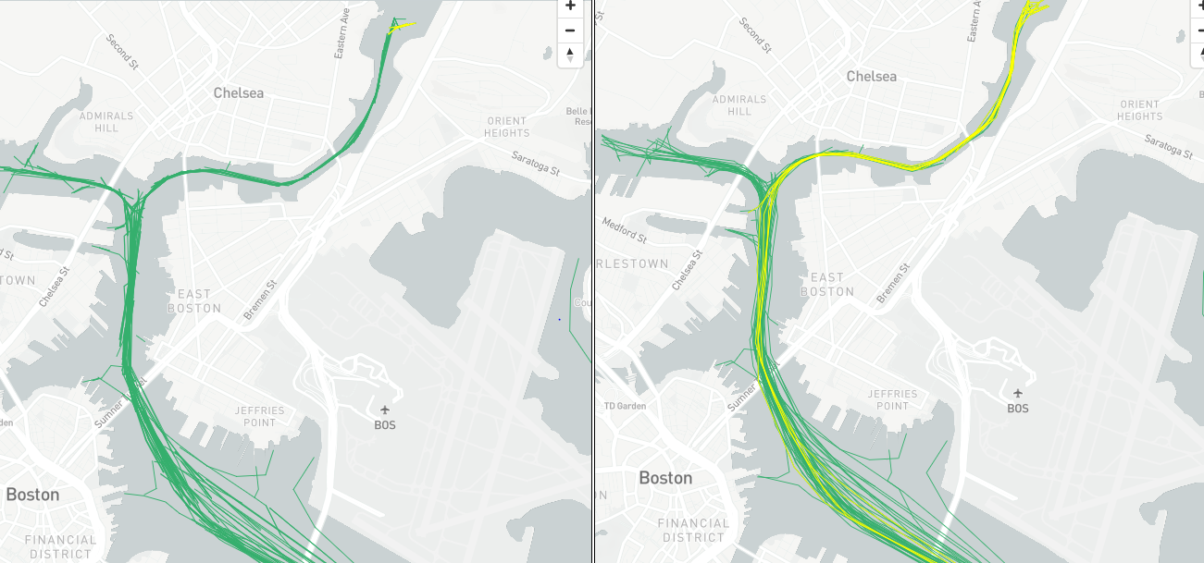
Bundle 1 Left: 12; Right: 13

Slide 4
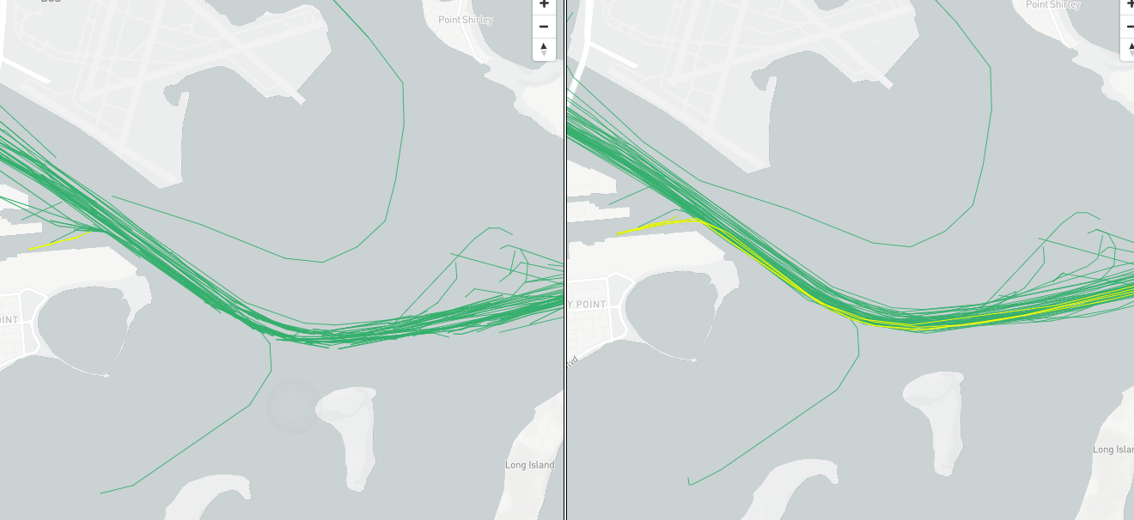
Bundle 2 Left: 12; Right: 13

Slide 5
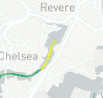
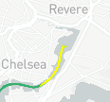
Bundle 3 Left: 10; Right: 11

Slide 6
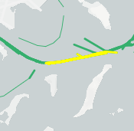
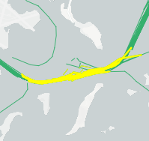
Bundle 4 Left: 10; Right: 11

Slide 7
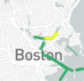
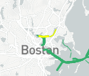
Bundle 5 Left: 8; Right: 9

Slide 8
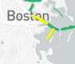
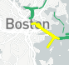
Bundle 6 Left: 8; Right: 9

Slide 9
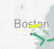
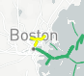
Bundle 7 Left: 7; Right: 8

Slide 10
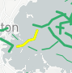
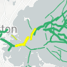
Bundle 8 Left: 7; Right: 8

Slide 11
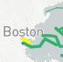
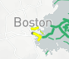
Bundle 9 Left: 6; Right: 7

Slide 12
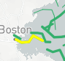
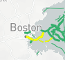
Bundle 10 Left: 6; Right: 7

Slide 13
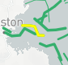
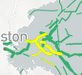
Bundle 11 Left: 6; Right: 7

Slide 14
Eps = 12, Y=1

Slide 15
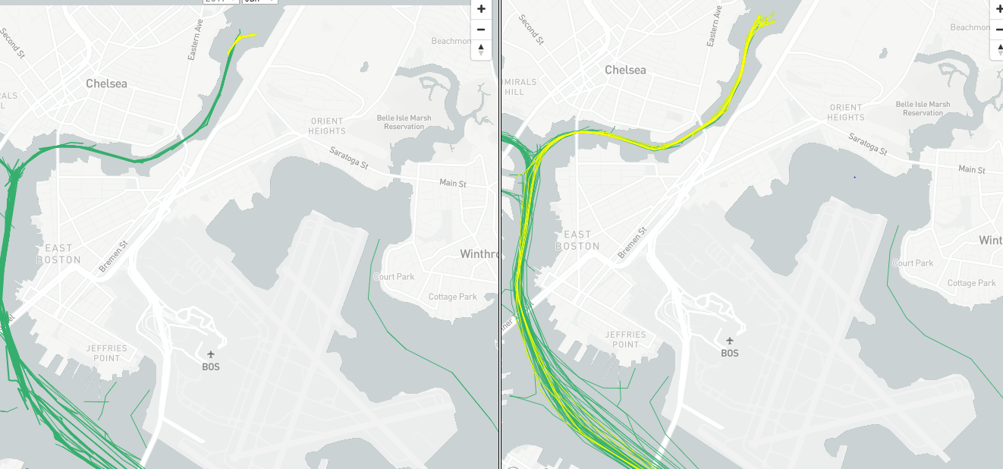
Bundle 1 Left: 12; Right: 13

Slide 16
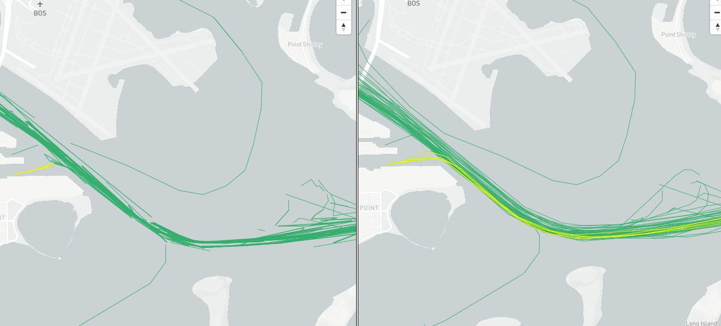
Bundle 2 Left: 12; Right: 13

Slide 17
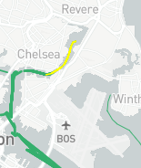
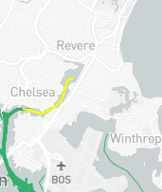
Bundle 3 Left: 10; Right: 12

Slide 18
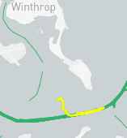
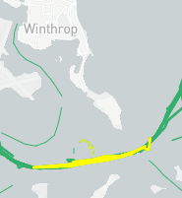
Bundle 4 Left: 10; Right: 11

Slide 19
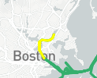
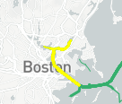
Bundle 5 Left: 8; Right: 9

Slide 20
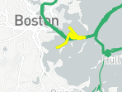
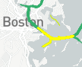
Bundle 6 Left: 8; Right: 9

Slide 21
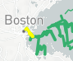
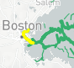
Bundle 7 Left: 7; Right: 8

Slide 22
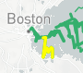
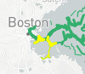
Bundle 8 Left: 7; Right: 8

Slide 23
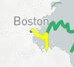
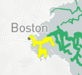
Bundle 9 Left: 6; Right: 7

Slide 24
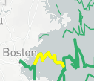
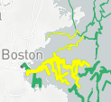
Bundle 10 Left: 6; Right: 7

Slide 25
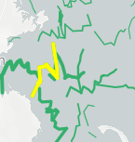
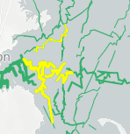
Bundle 11 Left: 6; Right: 7

Slide 26
Eps = 12, Y=2

Slide 27
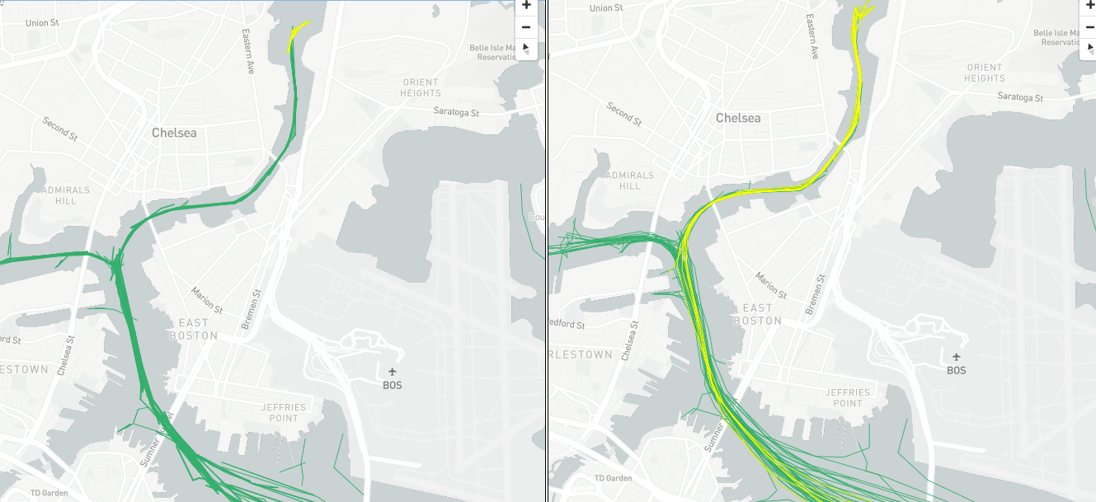
Bundle 1 Left: 12; Right: 13

Slide 28
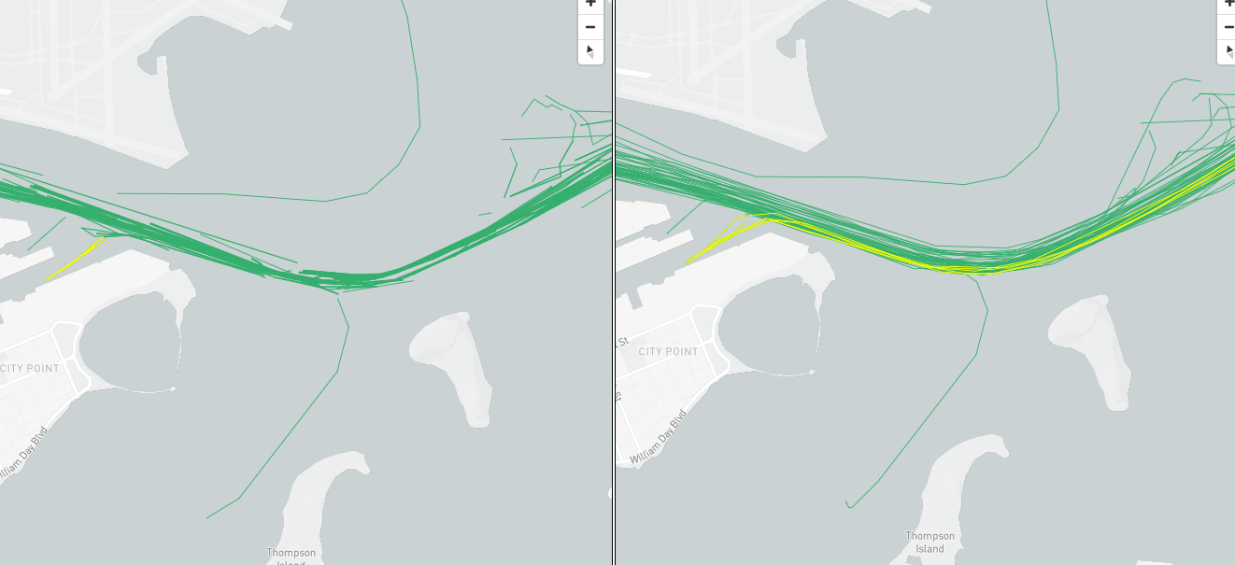
Bundle 2 Left: 12; Right: 13

Slide 29
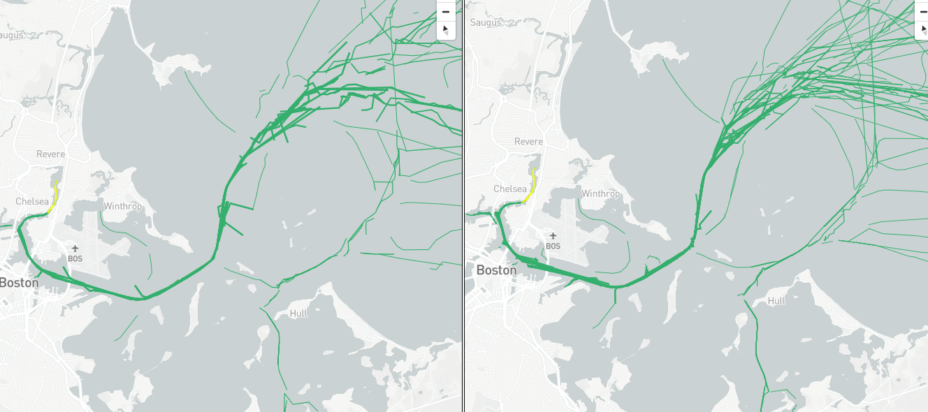
Bundle 3 Left: 10; Right: 11

Slide 30
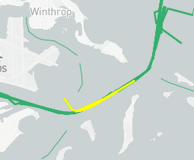
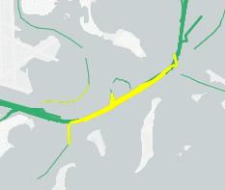
Bundle 4 Left: 10; Right: 11

Slide 31
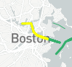
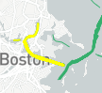
Bundle 5 Left: 8; Right: 9

Slide 32
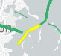
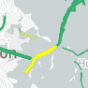
Bundle 6 Left: 8; Right: 9

Slide 33
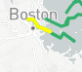

Bundle 7 Left: 7; Right: 8

Slide 34


Bundle 8 Left: 7; Right: 8

Slide 35


Bundle 9 Left: 6; Right: 7

Slide 36


Bundle 10 Left: 6; Right: 7

Slide 37


Bundle 11 Left: 6; Right: 7

Slide 38
Eps = 12, Y=3

Slide 39

Bundle 1 Left: 12; Right: 13

Slide 40

Bundle 2 Left: 12; Right: 13

Slide 41

Bundle 3 Left: 10; Right: 11

Slide 42


Bundle 4 Left: 10; Right: 11

Slide 43


Bundle 5 Left: 8; Right: 9

Slide 44


Bundle 6 Left: 8; Right: 9

Slide 45


Bundle 7 Left: 7; Right: 8

Slide 46


Bundle 8 Left: 7; Right: 8

Slide 47


Bundle 9 Left: 6; Right: 7

Slide 48


Bundle 10 Left: 6; Right: 7

Slide 49


Bundle 11 Left: 6; Right: 7

Slide 50
Eps = 15, Y= 4

Slide 51

Bundle 1 Left: 12; Right: 13

Slide 52

Bundle 2 Left: 12; Right: 13

Slide 53


Bundle 3 Left: 10; Right: 11

Slide 54


Bundle 4 Left: 10; Right: 11

Slide 55


Bundle 5 Left: 8; Right: 9

Slide 56


Bundle 6 Left: 8; Right: 9

Slide 57


Bundle 7 Left: 7; Right: 8

Slide 58


Bundle 8 Left: 7; Right: 8

Slide 59


Bundle 9 Left: 6; Right: 7

Slide 60


Bundle 10 Left: 6; Right: 7

Slide 61


Bundle 11 Left: 6; Right: 7

